Slide 1
Graduate Labour Economics:
Active labour market policies
Neil Rankin
Economics Department, Stellenbosch University
October 2017

Slide 2
Outline
An overview of Active Labour Market Policies (ALMP)
Empirical evidence
Two examples:
UK – Future Jobs Fund
SA – A wage subsidy

Slide 3
Readings
BETCHERMAN, G., GODFREY, M., PUERTO, S., ROTHER, F. and STAVRESKA, A., 2007. A review of interventions to support young workers: Findings of the youth employment inventory. World Bank Social Protection Discussion Paper, 715.
CALMFORS, L., 1994. Active labour market policy and unemployment: A framework for the analysis of crucial design features.
CARD, D., KLUVE, J. and WEBER, A., 2015. What works? A Meta Analysis of Recent Active Labor Market Program Evaluations
(This is an update of an earlier meta-analysis in 2010)
DEPARTMENT FOR WORKS AND PENSIONS, 2012. Impacts and Costs and Benefits of the Future Jobs Fund. UK Government.

Slide 4
What are active labour market policies?
‘Traditional’ approaches:
Demand stimulus
Fiscal and monetary policy
Other macro policies
Micro reform
Problems?
Supply-side structural reforms
Labour market rigidities
Characteristics of labour market participants
Problems?

Slide 5
What are active labour market policies?
Active labour market policies (ALMP)
Definition (Calmfors, 1994):
Measures in order to improve the functioning of the labour market that are directed at the unemployed
Active in the sense that they are specific policies put in place by government (or government agencies)
Another way to think about this is in the ‘matching’ model context: (most of) these types of polices don’t generally just think about the supply or demand but the interface

Slide 6
What are active labour market policies?
Types (Card et al, 2010)
Classroom or on-the-job training
Vocational training, apprenticeships
SA examples: learnerships and SETAs
Job search assistance or sanctions for failing to search
Matching and job-listings
SA examples: search subsidy, help with job search (Labour Centres)
Subsidised private sector employment
Wage subsidies
SA examples: Youth Employment Incenctives
Subsidised public sector emplyment
SA example: Expanded Public Works Programme (EPWP)
Programmes can have multiple aspects

Slide 7
A theoretical framework (Calmfors)
The Layard-Nickell model

Slide 8
A theoretical framework (Calmfors)
The Beveridge curve:
a measure of the effectiveness of the matching process
More vacancies correspond to lower unemployment since extra hirings need to be offset by fewer job matches due to smaller number of applicants if employment is to remain constant
Along Beveridge curve hirings exactly match quits in equilibrium (for employment to remain constant).
Intersection of curves in previous figure is A on Beveridge curve

Slide 9
A theoretical framework (Calmfors)
The Layard-Nickell model

Slide 10
A theoretical framework (Calmfors)
The Beveridge curve:
a measure of the effectiveness of the matching process

Slide 11
An example of ALMP
Training or job creation schemes
Shift RR curve leftwards
Reduces open unemployment
Gross (or bookkeeping) effect of the programme
To obtain the net effect one needs to take into account the indirect effects (on wage setting, labour demand and supply)

Slide 12
Aspects of the labour market which ALMPs affect
Matching, and thus quality of match
Labour market participation
Competition in labour market
Deadweight losses and substitution effects
Displacement effects via wage setting
Productivity effects
Work-test effects
General-equilibrium tax effects
Repercussions on other policies

Slide 13
Matching
ALMPs may facilitate better matching since:
Mismatch between different sub-sectors of labour markets may be eliminated;
May promote more active job search
ALMPs may substitute for work experience and thus reduce the uncertainty about work-seeker productivity
Impact of better matching is likely to reduce the number of job seekers per vacancy in equilibrium – a movement of the Beveridge curve to the left.
Will affect both employment and wage-setting schedules in Layard-Nickell diagram

Slide 14
Improved matching
The Layard-Nickell model
Vacancies are filled more quickly making them less costly to firms and thus more open up – equivalent to an increase in labour demands
Firms have less need to offer high wages to tempt workers
Employment increase in unambiguous but real wage is not

Slide 15
Matching
Need to think about net effects too
Individuals may be ‘locked-in’ and search effectiveness is reduced even before the programme starts, especially if the compensation for the programme is attractive
Also obviously need to think about the cost

Slide 16
Labour force participation
When unemployment is high many people may withdraw from the labour force (think about SA case here)
Low-level equilibrium
An ALMP may encourage individuals to remain in the labour market
Higher supply of labour relative to demand means more competition for available jobs and places downward pressure on wages (if institutional structure allows this)
Shift leftwards of the employment schedule

Slide 17
Effects on labour market participation
The Layard-Nickell model
Situation has deteriorated in sense that real wage is lower and that there is a higher proportion of people unemployed
Situation has improved since a fall in the real wage means more people are employed

Slide 18
Competition effects on insiders
ALMPs may specifically target outsiders: lower-skilled, long-term unemployed, those with limited links to potential jobs
Can increase the competitiveness of outsiders relative to insiders
Redistribution of employment opportunity
Shift downward of wage-setting schedule
Do you think this is important in SA context?

Slide 19
Improved competition for insiders
The Layard-Nickell model

Slide 20
Deadweight and substitution effects
Deadweight cost: hirings which would have occurred anyway
Substitution effect: change in relative wage costs will lead to substitution of one group by another

Slide 21
Displacement effects
This can have a number of dimensions:
May reduce the welfare loss to unemployment (ALMPs make unemployment less costly)
May require higher wages to induce people to remain employed (upward shift of wage-setting schedule)
Could also mean that firms which benefit from ALMPs have lower costs and can displace other firms, and workers in these firms, in their markets.

Slide 22
Productivity effects
Long-term unemployment has negative productivity effects:
Lost opportunities to accumulate skills on the job, especially if skills are changing
De-skilling – loss of existing skills
Training schemes designed to increase productivity but ALMPs which get people into, or keep people in, jobs may also do this
Analogous to an improvement in technology but not all technology improvements are labour-augmenting
Also how do real wages respond to changes in productivity?

Slide 23
ALMPs as work-tests
Not all those who are unemployed/drawing unemployment benefits are actually wanting to work
An ALMP can act as a work-test by threatening withdrawal of benefits if not enrolled
May reduce welfare costs
An issue where there is unemployment insurance

Slide 24
Tax effects
ALMPs have a cost – paid by the fiscus
How these are financed may matter
Think about payroll taxes in SA – a 1% tax on payroll. Who does this tax fall most heavily on?
But can also have benefits
Taking people off benefits
Broadening the tax base
Could depend on what other policies are in place

Slide 25
Empirical evidence
ALMPs occur in a specific context where implementation and labour market conditions differ across countries/cases
Makes it difficult to compare
Card et al (2015) undertake a meta-analysis (an aggregation of existing studies). Find that
Program estimates are on average close to zero in the short run, but become more positive in the medium and longer runs
The time profile of impacts varies by type of program, with the largest long term gains for programs that emphasize human capital accumulation (private work subsidies in this group);
Different participant groups benefit differentially, with larger gains for female participants and those entering from long term unemployment;
Active labour market programs are more likely to show a positive impact in recessions
Also public employment programmes relatively ineffective

Slide 26
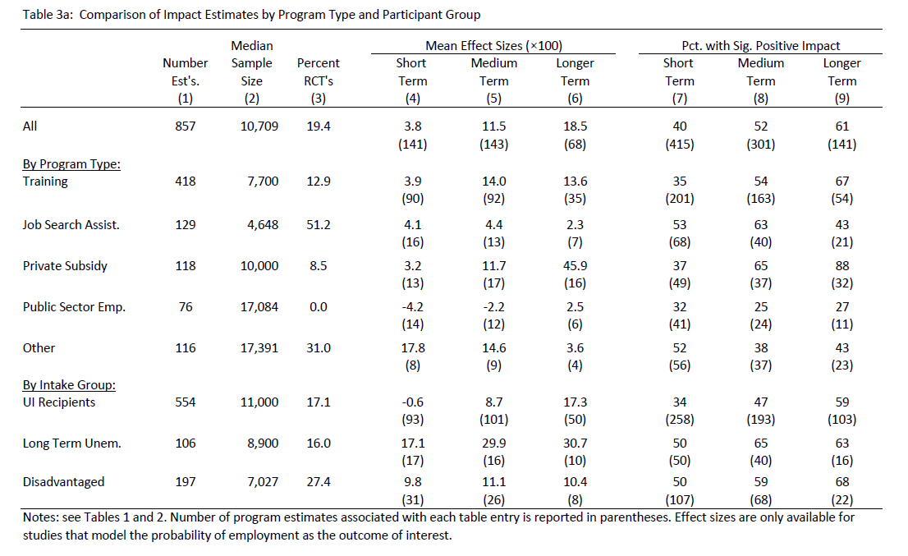
Empirical evidence
Table 3a.
Table 5

Slide 27
Empirical evidence
Table 5

Slide 28
Empirical evidence
Betcherman et al (2007) undertake an inventory of youth programmes and meta-analysis
Very few programmes are rigorously evaluated and contain any cost-benefit analysis – leads to an over-estimation of the effectiveness of programmes
Skills training is the most common intervention
No major differences in impact or cost-effectiveness across categories of interventions
Impact of employment interventions seems higher in transition and developing countries
Lower impact when labour markets are less flexible
Implications for SA

Slide 29
Two specific case studies
A wage subsidy voucher in South Africa (Levinsohn, Rankin, Roberts and Schӧer, 2013)
Increased probability of employment one and two years after allocation
Mechanisms unclear
The UK’s Future Jobs fund
Subsidised employment for unemployed young people who are disadvantaged in the labour market
Propensity score matching (PSM)
Shows broadly positive effects

Slide 30
A South African example
Youth unemployment in SA is high and rising
One government proposal is a set of Youth Employment Incentives – one of which is a targeted temporary wage subsidy which would be claimed by firms through the tax system
Two sources of existing literature:
Subsidies in other countries – evidence is mixed (context matters)
South African CGE simulations (Go et al, 2010; Burns et al 2010), but key assumption is size of wage elasticity
A randomised control trial (RCT) is one way to get some understanding on the potential impact of a wage subsidy

Slide 31
Why an RCT?
Empirical micro-economists generally worry about two things:
Heterogeneity (which is generally unobserved)
Selection into a programme/state etc
Usually this ends up in the error term and because it is usually correlated with the RHS variable whose impact you are interested in, the coefficient estimate on that RHS variable is biased
Solution is to look for something exogenous which would help to identify the effect but which is uncorrelated with the error term:
IVs
Natural experiments
RCTs

Slide 32
Why an RCT?
With an RCT the exogeneity is introduced by the researcher who randomly assigns participants to a treatment or control group
Done correctly, and with a large enough sample, on average these two groups are the same (including unobservables which are randomly distributed)
The only thing which differs between the two groups is exposure to the policy/programme/treatment
This means that any observed differences post-exposure can be attributed to the policy/programme/treatment

Slide 33
Is this a test of the actual policy?
No
Not structured in the same way as the National Treasury proposal
Different amount
Legitimacy?
External validity

Slide 34
Methodology
Initial baseline in 2009 (of approximately 4,000 young people)
Drawn from Gauteng, Durban and surrounds, Polokwane and surrounding rural areas – Labour Centres and dwelling units
Second baseline and allocation of vouchers (to all) in 2010
Voucher allocation based on pair-wise matching, where individuals were matched on geographical location, gender, education, age, number of earners in household, and activity in 2009
Follow up in 2011 and second follow up in 2012
Vouchers initially expired in March 2011 but renewed for one more year

Slide 35
Impact of the voucher one year later

Slide 36
Impact of voucher two years later (2012)

Slide 37
What could explain this effect?
Understanding of the voucher
Ask individuals and then instrument with allocation, remains significant.
Also use whether the individual used the voucher, falls out if included with understanding
Firm take up
Behaviour of individuals
Search
Movement
Turned down job offers
Attrition
Certain types of individuals are likely to remain in the sample and this differs between the treatment and control groups.

Slide 38
Firm take up or enquiry

Slide 39
Changes in search?

Slide 40
Turned down job offers?

Slide 41
Mechanism through which it works
Queuing for higher income jobs (and can afford to)
Flow of information
Liquidity constraints

Slide 42
What about attrition

Slide 43
Conclusions
There is a relatively large and robust treatment effect in terms of the probability of being in wage employment
This effect lasts even after the lapse of the voucher and those with the voucher have longer spells of work experience two years later
Getting young people into jobs earlier can have a longer-term effect
Effect related to understanding the voucher
Low firm take up
No difference in search behaviour
Those with vouchers in households with working members are less likely to turn down job offers (explains about 3 percentage points of the coefficient estimate)
Not driven by attrition

